Slide 1





Slide 2

TITLE
Insert copy here.

Slide 3
TITLE
Insert copy here
For your footnote

Slide 4
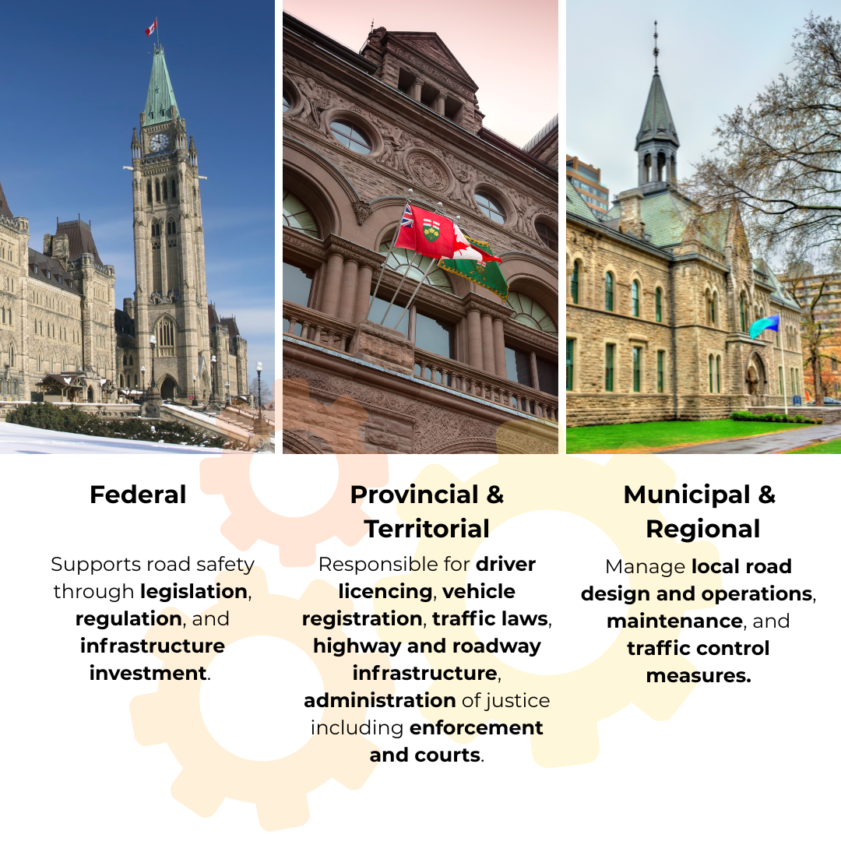
GOVERNANCE AND ENGAGEMENT
Federal
Provincial
Municipal

Slide 5
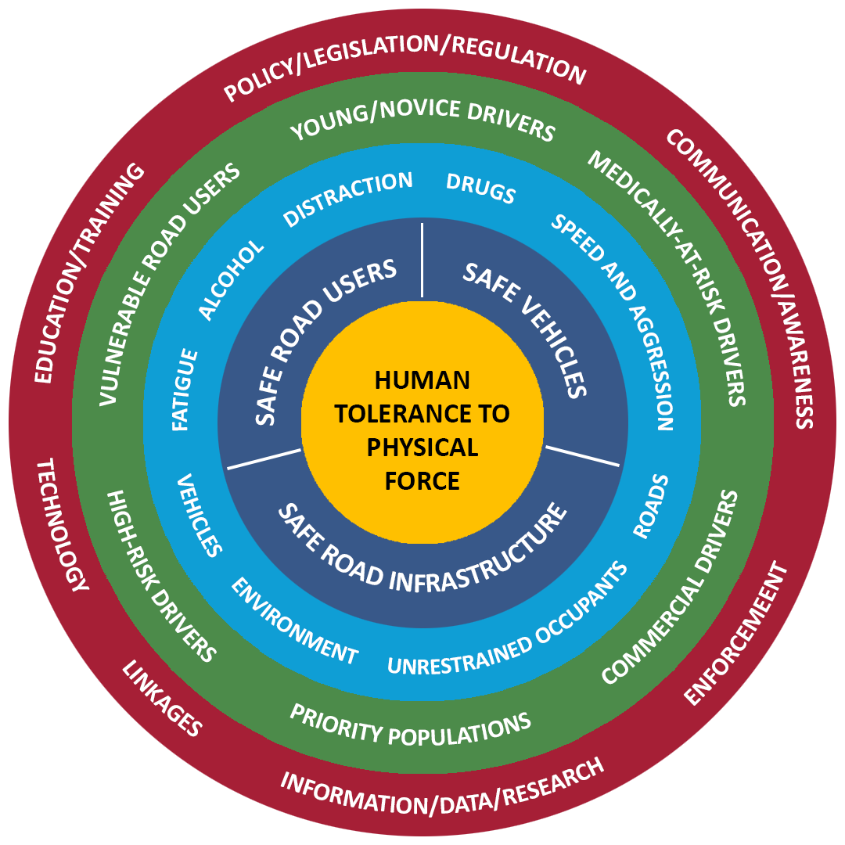

RSS 2035+
 | The core of the safe systems approach is the protection for all road users
 | The key to the safety systems approach is safe road users, safe vehicles and safe infrastructure working in unison to make a safe system
 | Identified key contributing factors in RSS 2035+
 | Identified key risk groups in RSS 2035+
 | Key safety intervention tools to address risk groups and contributing factors

Slide 8

Canadian Council of Motor Transport Administrators (CCMTA)
Conseil canadien des administrateurs en transport motorisé
404 - 1111 promenade Prince of Wales Drive
Ottawa (ON) K2C 3T2
(613) 736.1003
info@ccmta.ca
Visit the RSS Website

