Slide 1





Slide 2

1,964 road fatalities & 9,261 serious injuries
in 2023¹
FOREWORD
Road safety is a shared responsibility and a national priority. Every year, too many lives are lost or forever changed due to road collisions. These tragedies are preventable.
Over the past decade, Canada has experienced a gradual but uneven trend in road safety outcomes. While long-term data show a significant decline in fatalities and serious injuries— down 28% and 41% respectively compared to 20 years ago—recent years have seen concerning reversals.
1 Canadian Motor Vehicle Traffic Collision Statistics: 2023

Slide 3
TOWARDS ZERO: A SAFE ROAD SYSTEM
FOR ALL CANADIANS
The strategy is guided by the vision “Towards Zero: A Safe Road System for All Canadians”, with the goal of continuing the long-term decline in road-related deaths and injuries.
As a renewed framework, RSS 2035+ focuses on reducing the absolute number of fatalities and serious injuries, measured against a rolling three-year baseline – because one life lost is too many.
By fostering collaboration, innovation, and evidence-based action,
RSS 2035+ reflects a renewed commitment towards a safer, more inclusive, and sustainable road system.

Slide 4
CONTRIBUTING FACTORS
AND INTERVENTIONS
The strategy also addresses persistent contributing factors such as:
distracted driving
impaired driving
fatigue
speeding
and environmental conditions.
To mitigate these risks, it promotes a range of interventions, including policy and legislation, education and training, public awareness, enforcement, data and research, vehicle and infrastructure technologies, and strategic partnerships.

Slide 5
Fatalities and serious injuries are trending upwards since 2020
GOAL OF RSS 2035+
This strategy provides guidance to jurisdictions in the development of their individual safety plans. The goal is to encourage jurisdictions to work collectively and promote national consistency.
Increases were observed in speeding, vulnerable road user safety and impaired driving; both alcohol and drugs.
Vehicles designs are changing rapidly with an increased use of touch screen and other technologies, which may both assist drivers and contribute to distraction. This context underscores the critical need for a renewed, data and research-driven strategy to reverse these trends and protect all road users.

Slide 6
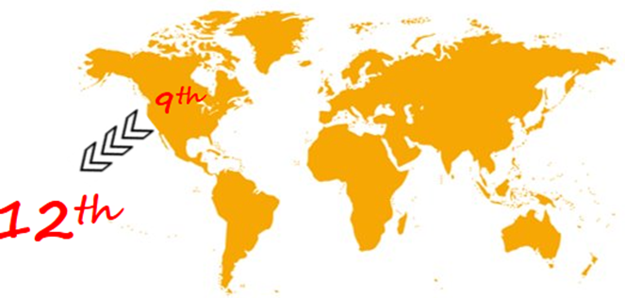
WORLD RANKINGS
Canada’s ranking in terms of road fatalities per billion vehicle-kilometers travelled (VKT) for 2023 is 12th with roughly 4.7 fatalities per billion VKT, behind countries such as the United Kingdom, Germany, Australia, and the leading Scandinavian countries, but ahead of countries like the Netherlands, France and the United States².
This represents a decrease in our relative position from 2021 where Canada ranked 9th and is similar to our position in 2015 (12th place with 5.1 fatalities per billion VKT).
2 International Transportation Forum (2024), Road Safety Annual Report 2024, OECD Publishing, Paris.

Slide 7
PURPOSE
The purpose of Canada’s RSS 2035+ is to provide a national framework that guides and supports coordinated efforts to eliminate fatalities and serious injuries on Canadian roads.
Rooted in the SSA and the vision of “Towards Zero,” the strategy aims to align the actions of all road safety partners—governments, industry, non-governmental organizations, and the public—toward a common goal of safer, more inclusive, and sustainable mobility.

Slide 8
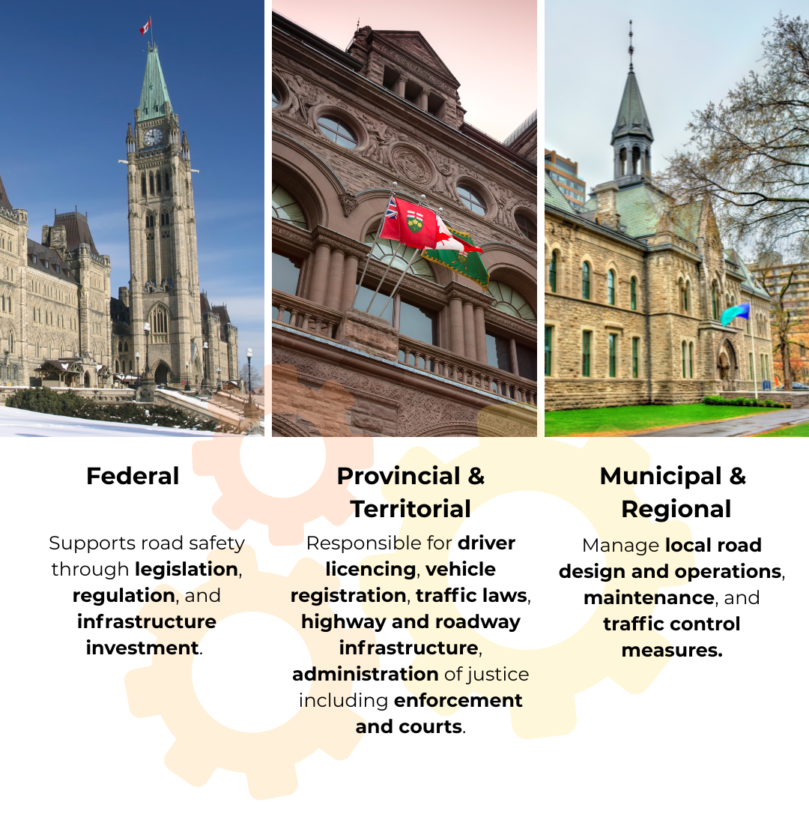
Government Roles
While the strategy does not prescribe a uniform plan, it encourages each jurisdiction to develop and publish its own road safety strategy tailored to local needs and legal frameworks and also reflects the input of non-governmental safety partners.
Federal
Provincial
Municipal

Slide 9
Industry and other collaborators
Beyond government, industry plays a vital role in advancing vehicle safety technologies, promoting safe fleet operations, and supporting innovation.
Under Canada’s self-certification model, manufacturers and importers are responsible for ensuring that their vehicles, tires, and child restraint systems comply with all applicable Canadian safety standards at the time of manufacturing. They are also required to issue a recall when a safety-related defect or non-compliance is found.
All road users—drivers, pedestrians, cyclists, and transit riders—share responsibility for safe behaviour on the roads. Collaboration can also occur at the community level, ensuring that road safety plans meet the needs and concerns of local road users.

Slide 10
OTHER FACTORS
While the focus of RSS 2035+ is road safety — the new strategy acknowledges how road safety issues intersect with other factors within the road transportation network, such as climate change and environmental considerations, promoting public transportation, changing national trade and international issues related to the vehicle fleet, as well as equity, accessibility, and public health goals.
Overall fatalities and serious injuries have increased since 2020 and certain unsafe behaviours related to speed, impairment and driver distraction have increased over this time period.

Slide 11
A LIVING DOCUMENT
The road safety environment in Canada has seen significant changes over the course of the previous plans. To address the evolving nature of transportation safety, RSS 2035+ will be an open-ended strategy and a living document that allows for ongoing updates as appropriate:
Monitoring the fatality and industry data
Measure the impact of Strategic Objectives
Update the Strategy based on the latest research and evaluation
Determining modern and effective ways to share best practices

Slide 12
VISION
The vision for RSS 2035+ is Towards Zero: A Safe Road System for All Canadians.
This vision continues Canada’s long-standing goal of having the safest roads in the world and is consistent with the Canadian Council of Motor Transport Administrators' (CCMTA) vision of having the safest and most efficient movement of people and goods in the world.

Slide 13

OVERALL GOAL
The overall goal of RSS 2035+ is to achieve a downward trend in the actual number of fatalities and serious injuries.
This will be measured year-over-year compared to a rolling 3-year average.
Jurisdictions may also choose to include rate-based reporting in their individual plans to offset population changes over the same period.

Slide 14

NEW IN RSS 2035+
The new vision “Towards Zero: A Safe Road System for All Canadians”
Addition of "priority populations group" (such as newcomers, aging and mature drivers, and users of evolving travel modalities)
Focus on reducing the absolute number of fatalities and serious injuries, measured against a rolling three-year baseline
Supports the United Nations Decade of Action for Road Safety 2021-2030 and its goal of a 50% reduction in deaths and injuries by 2030
Outlines eight strategic objectives
Includes an Implementation Plan and a Dedicated Working Group
Emphasizes the importance of ongoing evaluation and accountability, with the goal of monitoring and updating the strategy on a regular basis to keep up with the rapidly evolving nature of road safety.

Slide 15
GROUNDED IN SSA
Canada’s RSS 2035+ is grounded in the Safe System Approach (SSA), an internationally recognized framework that acknowledges the inevitability of human error and the need to design a transportation system that prevents those errors from resulting in death or serious injury⁵.
By embedding these principles into road safety planning, design, and operations, the SSA supports a long-term vision towards zero fatalities and serious injuries.
The SSA is built on the following core principles: ​
​
Deaths and serious injuries are unacceptable​
People Make Mistakes ​
Human Vulnerability ​
Shared Responsibility ​
Redundancy and Layered Protection ​
Proactive and Equitable Design
⁵ https://toolkit.irap.org/management/safe-system-approach/

Slide 16
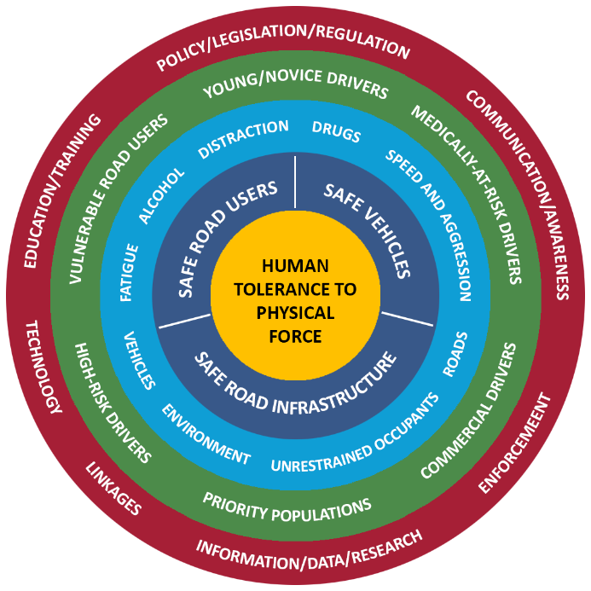
RSS 2035+
The diagram is meant to graphically represent RSS 2035+, with human safety at the centre, the other layers representing key systems, contributing factors, risk groups and tools to effect change as per the legend.
 | The core of the safe systems approach is the protection for all road users
 | The key to the safety systems approach is safe road users, safe vehicles and safe infrastructure working in unison to make a safe system
 | Identified key contributing factors in RSS 2035+
 | Identified key risk groups in RSS 2035+
 | Key safety intervention tools to address risk groups and contributing factors

Slide 17
STRATEGIC OBJECTIVES
To support the vision of Towards Zero, RSS 2035+ outlines eight strategic objectives that provide a foundation for coordinated, evidence-based, and accountable road safety action across Canada. These objectives are designed to guide jurisdictions in developing and implementing effective safety plans while fostering national consistency and collaboration and keeping the strategy alive through 2035.
Leadership and Commitment​
2. Good Governance ​
3. Data and Evidence ​
4. Modern Regulation and Policy
5. Awareness, Education, and Training
6. Safe Vehicles and Infrastructure
7. Enforcement and Compliance
8. Leveraging Technology

Slide 18
RISK GROUP | DEFINITION
Young/Novice Drivers | Drivers who are under the age of 25 and/or have less than 2 years of driving experience. The U-curve of collision risk shows that young and new drivers are at a higher collision risk due to their age and inexperience.
Medically-at-Risk Drivers | Medically at-risk drivers, regardless of age, have medical conditions or medication side effects that impair their ability to drive, putting themselves, their passengers and others on the road in danger.
Vulnerable Road Users | Pedestrians, motorcyclists, cyclists and persons in personal mobilized devices (e.g., motorized wheelchairs and scooters). Evidence shows that VRUs are at higher risk due to the lack of a defensive shell of a vehicle in a collision.
Commercial Vehicle Drivers | Commercial vehicles drivers (e.g., vehicles over 4,586 kg or passenger transportation). These vehicles have significant mass and drive significantly more miles than smaller vehicles. These factors have a significant impact on collision risk for these vehicles. Commercial vehicle drivers typically represent 5% of road users, but their collisions are associated 20% of road fatalities.
High Risk Drivers | Repeat offenders with a pattern of illegal driving behaviours (e.g., recurring incidences of alcohol/drug impaired driving, traffic violations, collision involvement, or suspended/prohibited drivers). Evidence shows that they have an increased rate of collisions and/or enforcement actions.
Priority Populations | Additional groups that may benefit from a community-informed approach, shaped through inclusive engagement to reflect jurisdictional and community needs. Such as: Users of evolving travel modalities and shared streets (ATVs, snowmobiles, or micromobility devices such as eScooters and eBikes). Newcomers to Canada, who may lack experience specific to Canadian road transportation Rural and remote communities that may face different challenges than urban populations Specific mobility needs and considerations for aging and mature drivers. Others as appropriate.
KEY RISK
GROUPS
Identified key risk groups remain an integral part of RSS 2035+, serving to guide jurisdictions and safety partners on the populations that have the highest risk of fatalities and injuries on our roads.
RSS 2035+ also identifies a new category, labeled Priority Populations.
This category allows jurisdictional safety plans to address additional groups according to jurisdictional needs.

Slide 19
CONTRIBUTING FACTOR | DEFINITION
Distracted Driving | Distracted driving occurs when a driver’s attention is diverted from the driving task by secondary activities (e.g., eating, talking to passengers, talking or texting on electronic communication devices (ECDs) such as smart phones).
Alcohol Impaired Driving | Physical or cognitive impairment of a road user which is caused by the consumption of alcohol. Recent evidence suggests a possible increase in alcohol impaired driving.
Drug Impaired Driving | Physical or cognitive impairment of a road user that is caused by the consumption of psychotropic drugs (e.g., cannabis, prescription drugs, narcotics, etc.), prescription drugs or over the counter drugs. Monitoring is necessary to identify impairing substances being used by drivers and the impact of the legalization of cannabis on road safety.
Fatigue Impaired Driving | Fatigue is a general state caused by lack of sleep, time of day, time on task, or task monotony, which diminishes the ability to drive by altering alertness and vigilance.
Speed and Aggressive Driving | Includes driving at speeds beyond posted legal limits or driving too fast for road conditions and driver behaviours which are deemed illegal or outside socially acceptable norms, which put other road users at risk (e.g., tailgating, improper passing, failure to signal, etc.).
Unrestrained Occupants | Includes factors pertaining to proper restraint use by all road users (e.g., seat belts, child safety seats, booster seats). This includes differential rates of use in urban versus rural driving,
Environmental Factors | Includes factors that may affect the likelihood of crash occurrence or the severity of the crash (e.g. weather conditions, wildlife on the road, time of day and light conditions). This category could include emergency preparedness for high impact weather or fire events.
Road Infrastructure | Includes factors that may affect the likelihood of crash occurrence or the severity of the crash (e.g., roadway configuration, road construction, road surface condition, road and roadside design, lighting and signage).
Vehicle Factors | Includes factors related to vehicle design (e.g., crash avoidance, crashworthiness), maintenance, recalls, aftermarket vehicle equipment, commercial vehicles, unusual vehicles, electric vehicles, automated vehicles, and new and emerging vehicle technologies.
CONTRIBUTING
FACTORS
The key contribution factors form the next level of the road safety matrix,
identifying the primary ways in which risk can be elevated, and that road safety plans can target to reduce fatalities and injuries.

Slide 20
INTERVENTION TYPE | DEFINITION
Policy/Legislation/ Regulation | Includes evidence-based policies, laws, and regulations intended to promote safe road user behaviour and the safety of the road infrastructure and vehicles.
Education/ Training | Includes activities that provide knowledge and/or test the capacity of a person to demonstrate appropriate behaviour with respect to road safety (e.g., proactive and remedial education, driver training, child restraint training).
Communication/ Awareness | Includes any activities that contribute to attitudinal change, increased awareness and knowledge related to key road safety issues by the road users or target audience that may lead to safer road user behaviour. (e.g., ad campaigns, social media, etc.).
Enforcement | Includes enforcing laws and regulations, preventing and investigating offences and promoting awareness and education for safe roadways (e.g., enhanced Check Stops, Selective Traffic Enforcement Programs (STEP), intelligence-based enforcement, automated enforcement, commercial vehicle inspections).
Information/Data/ Research | Includes capturing and compiling complete, uniform and timely data (e.g., crash, trauma, exposure) to expedite the identification of emerging trends/issues for the further development of evidence-based road safety interventions. This also includes the evaluation of road safety measures and the monitoring of road safety indicators over time as well as using scientific models from the multiple disciplines that operate in the road safety domain.
Technology | Includes using technology and innovation to improve the safety of the driver (e.g., installment of alcohol ignition) interlock, speed and red-light cameras); vehicle (e.g., automatic emergency braking, other advanced driver assistance systems) and infrastructure (e.g., Intelligent Transportation Systems, roundabouts). Technological improvements in data collection and analysis as well as artificial intelligence methods for monitoring international safety countermeasures.
Linkages | Includes the establishment of linkages between jurisdictional, national or international governmental and non-governmental organizations with a vested interest in road safety, as well as engagement with local communities. This will foster partnerships, knowledge sharing and best practice guidelines, and improve cooperation and collaboration among key road safety stakeholders (e.g., police, health professionals, etc.). Community engagement helps to tailor road safety plans and interventions to the unique needs of the population and improves public trust and acceptance towards a culture of road safety.
INTERVENTIONS
For each risk group and contributing factor, there may be more than one intervention for promoting safer road users, safer infrastructure and safer vehicles. A combination of interventions could result in even greater improvements to safety, such as the important combination of enforcement with communication and awareness.

Slide 21
GOVERNANCE AND ENGAGEMENT
A collaborative governance model
The strategy is overseen by the Council of Ministers Responsible for Transportation and Highway Safety (CoM), which provides high-level direction and support.
Operational leadership is provided by the Canadian Council of Motor Transport Administrators (CCMTA), which, as the custodian of the RSS 2035+, facilitates intergovernmental collaboration, data sharing, and the development of national guidelines, best practices to support safety programs, and supports continuous learning and the identification of evidence-based interventions and technologies.

Slide 22
REPORTING AND EVALUATION
RSS 2035+ will be a flexible and adaptable living document subject to changes when and as appropriate—determined in response to changes in road safety. It is recommended that the monitoring and ongoing evaluation framework for the strategy include the collection of data from jurisdictions on an annual basis. Data will include metrics and key performance indicators towards the strategy's Strategic Objectives, in addition to all available data on fatalities and serious injuries.

Slide 23
CONCLUSION
Canada’s RSS 2035+ is a framework representing a renewed commitment to improving safety in the Canadian transportation network, such that no one is killed or seriously injured on our roads. Grounded in the SSA and supported by a collaborative governance model, the strategy reflects a national commitment to continuous improvement, innovation, and shared responsibility.
By working together, learning from one another, and staying focused on our shared goal, we can build a safer, healthier, and more sustainable transportation system for all Canadians.

Slide 24

Canadian Council of Motor Transport Administrators (CCMTA)
Conseil canadien des administrateurs en transport motorisé (CCATM)
404 - 1111 promenade Prince of Wales Drive
Ottawa (ON) K2C 3T2
(613) 736.1003
info@ccmta.ca
Visit the RSS Website

